Slide 1
Regressions
Teresa Zhu

Slide 2
Regression – What Is It?
Regression modeling is a modeling technique that we use to analyze and estimate the values of a (response) variable by using other variables that it's correlated with.
Many problems in engineering and science involve exploring the relationships between two or more variables. Regression is a statistical technique that is very useful for these types of problems.

Slide 3
Variables in Regression
The regression framework is characterized by the following:
We have one particular variable that we are interested in understanding or modelling, such as sales of a particular product, or the stock price of a publicly traded firm. This variable is called the response (dependent) variable, and is usually represented by Y.
We have a set of other variables that we think might be useful in predicting or modelling the response variable (say the price of the product, the competitors’ price, and so on; or the profits, revenues, financial position of the firm, and so on). These are called the predicting or explanatory (independent) variables, and are usually represented by x1, x2, etc.

Slide 4
Variables in Regression
RESPONSE VARIABLE versus PREDICTING VARIABLE?
Response Variable: It is a Random Variable. It varies with changes in the predictor/s along with other random changes.
Predicting Variable: It is a Fixed Variable. It does not change with the response, but it is set fixed before the response is measured.

Slide 5
Response vs Predicting Variable
The effect of several types of cholesterol medications on LDL levels in humans.
Response Variable: Change in LDL levels
Predicting Variable: Type of Medication
The relationship between driving habits and fuel efficiency
Response Variable: Miles Per Gallon (MPG) of Fuel
Predicting Variable: Average Driving Speed
The relationship between college grade point average (GPA) and scores on the SAT
Response Variable: GPA
Predicting Variable: SAT score

Slide 6
Objectives in Regression Analysis
A regression analysis is used for:
Prediction of the response variable;
Modelling the relationship between the response variable and the explanatory variables; or
Testing hypotheses of association relationships.
Linear Regression: The basis of what we will be talking about most of this course is the linear model. Virtually all other methods for studying dependence among variables are variations on the idea of linear regression.
“All models are wrong, but some are useful. “ George Box
“Embrace your data, not your models.” John Tukey

Slide 7
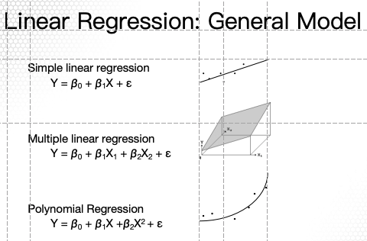
Whether a linear or polynomial model in X, we can estimate the relationship using linear regression.

Slide 8
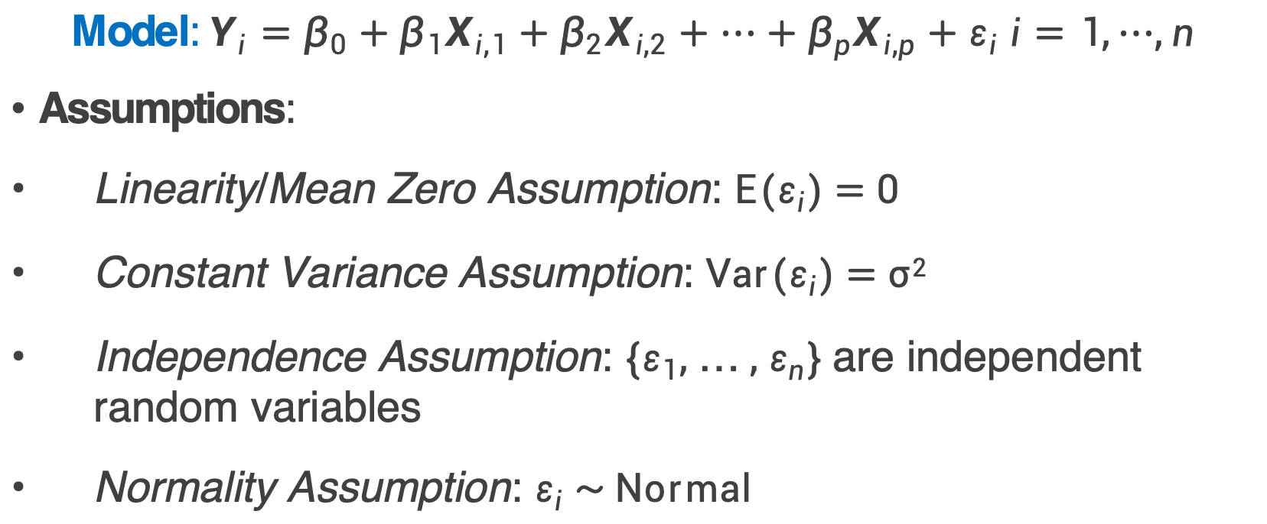
Linear Regression
$$\text{Model}\text{:} {Y_{i}=β}_{0}+β_{1}X_{i,1}+β_{2}X_{i,2}+⋯+β_{p}X_{i,p}+ε_{i} i=1,⋯,n$$
Assumptions:
Linearity/Mean Zero Assumption: E($ε_{i}$) = 0
Constant Variance Assumption: Var($ε_{i}$) = σ²
Independence Assumption: {$ε_{1}$, … , $ε_{n}$} are independent random variables
Normality Assumption: $ε_{i}$ ~ Normal

Slide 9

Linear Regression for Yes/No Question?
Uber recently changed their logo.
You are asked to model whether Uber users will like the new logo based on how much they spent using Uber 3 months after the logo changed.

Slide 10
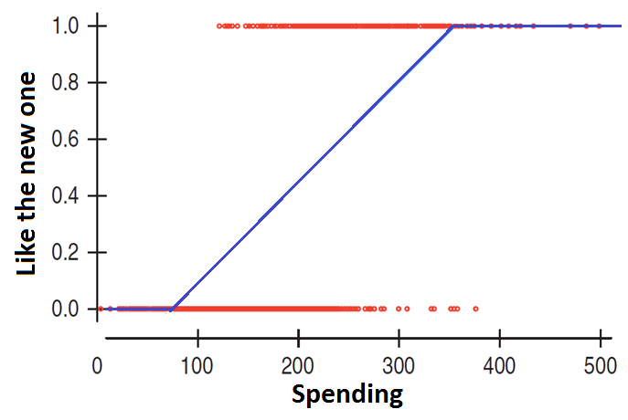
What Is Wrong with Linear Regression?
Customers will not behave like this!

Slide 11
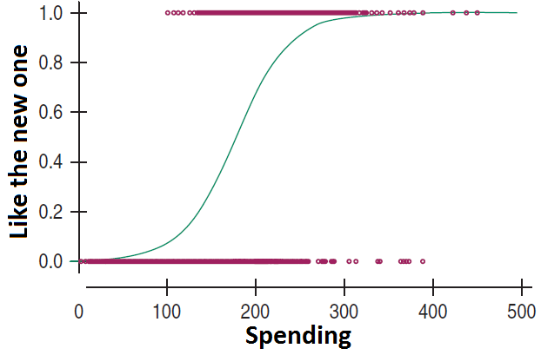
S-shaped Curve

Slide 12
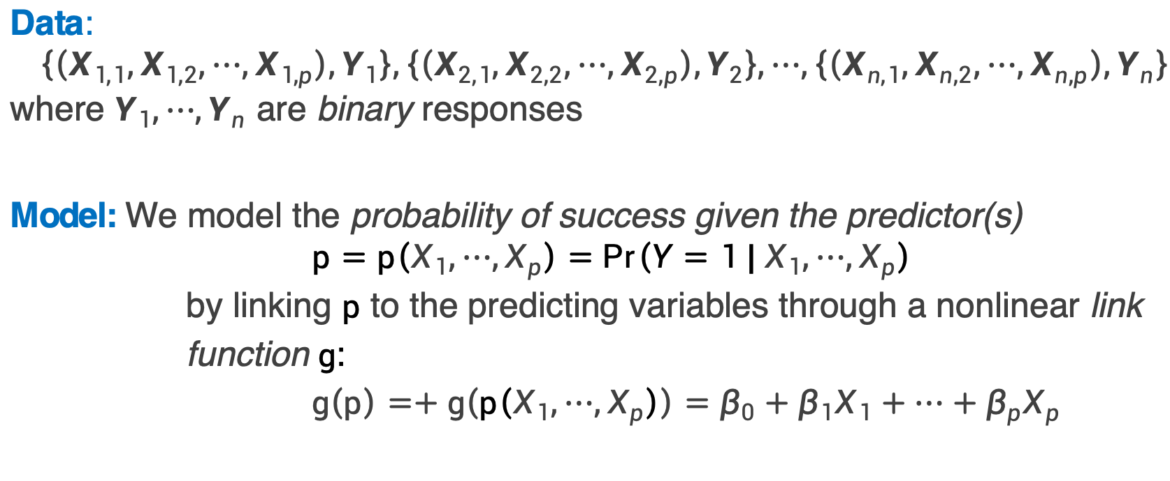
Logistic Regression Model
Data:$\left\{\left(X_{1,1},X_{1,2},⋯,X_{1,p}\right),Y_{1}\right\},\left\{\left(X_{2,1},X_{2,2},⋯,X_{2,p}\right),Y_{2}\right\},⋯,\left\{\left(X_{n,1},X_{n,2},⋯,X_{n,p}\right),Y_{n}\right\}$where $Y_{1},⋯,Y_{n}$ are binary responses
Model: We model the probability of success given the predictor(s)
$$p=p\left(X_{1},⋯,X_{p}\right)=Pr\left(Y=1 |{ X}_{1},⋯,X_{p}\right)$$
by linking $p$ to the predicting variables through a nonlinear link function $g$:
$$g\left(p\right)=+g\left(p\left(X_{1},⋯,X_{p}\right)\right)=β_{0}+β_{1}X_{1}+⋯+β_{p}X_{p}$$

Slide 13
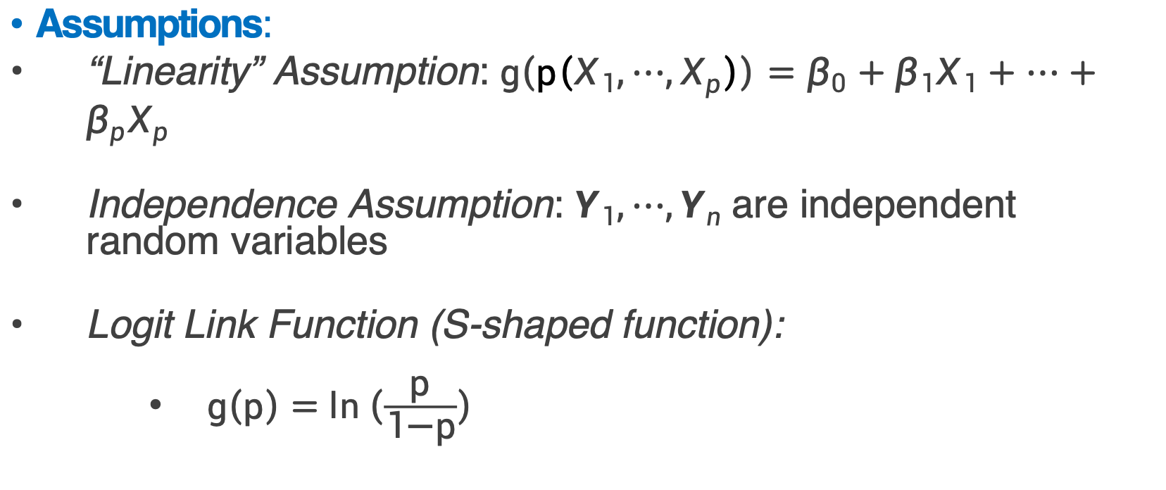
Logistic Regression Model
Assumptions:
“Linearity” Assumption: $g\left(p\left(X_{1},⋯,X_{p}\right)\right)=β_{0}+β_{1}X_{1}+⋯+β_{p}X_{p}$
Independence Assumption: $Y_{1},⋯,Y_{n}$are independent random variables
Logit Link Function (S-shaped function):
$\text{g}\left(\text{p}\right)\text{ = }\text{ln}\left(\frac{\text{p}}{\text{1}\text{−}\text{p}}\right)$

